Slide 1
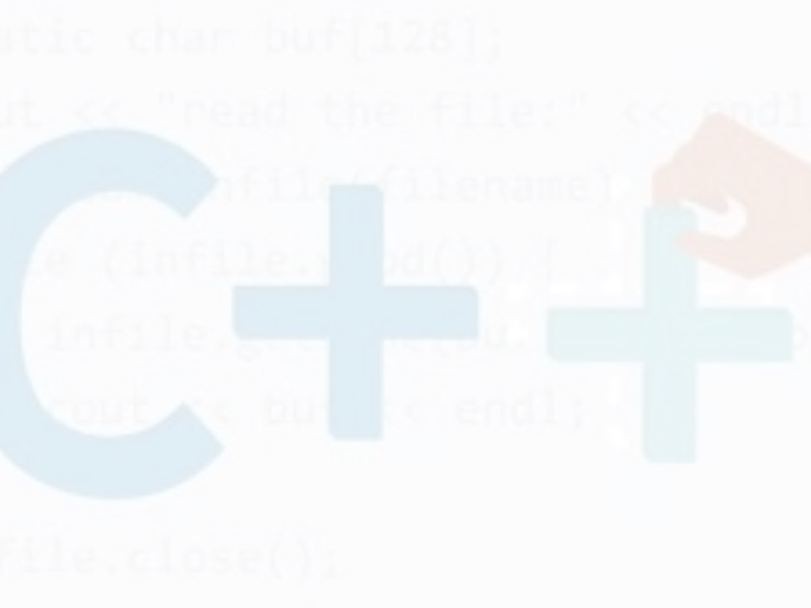
Sub Module:4 Control Statements
Introduction
In this chapter, you will learn various selection and loop control statements. C++provides selection statements that let you choose actions with two or more alternative courses. 
C++ provides a powerful control structure called a loop, which controls how many times an operation or a sequence of operation is performed in succession

Slide 2
Control Statements
Control statements are statements that alter the sequence of flow of instructions.
Any single input statement, assignment and output statement is simple statement.
A group of statement that are separated by semicolon and enclosed within curled braces { and } is called a block or compound statement. The order in which statements are executed in a program is called flow of control

Slide 3
Types of control statements:
C++ supports two basic control statements. Selection statements
Iteration statements

Slide 4
Selection (condition) Statements:
This statement allows us to select a statement or set of statements for execution based on some condition.
This structure helps the programmer to take appropriate decision based on a given condition.
Sometimes we need to execute a block of statements only when a particular condition is met or not met. This is known as Decision Making.
As we executing a certain program after making a decision in the program logic

Slide 5
Conditional statements
If the condition evaluates to True, a set of statements is executed, otherwise another set of statements is executed
A conditional statement allows us to control whether a program segment is executed or not

Slide 6
Types of Selection Statements
For decision making in C++, There are four forms of Decision Making statements in C++.
if ……statement
if……else statement
if….else-if….else statement
nested if statement
switch statement

Slide 7
The if Statement:
This is the simplest form of if statement. This statement is also called as one-way branching.
This statement is used to decide whether a statement or set of statements should be executed or not.
The decision is based on a condition which can be evaluated to TRUE or FALSE.
.

Slide 8
The syntax of the if… statement is
if(condition/expression)
{
//body of if statements
}
if (condition)
{
statement 1;
statement 2;
statement 3;
}

Slide 9
if…statement
.
The if statement evaluates the condition/expression inside parenthesis ( ).
If the condition (expression) evaluates to true, then a code or set of statement(s) inside the body of if is executed.
If the condition evaluates to false, the code inside the body of if is skipped
and the program control passes to the statement following the if statement

Slide 10
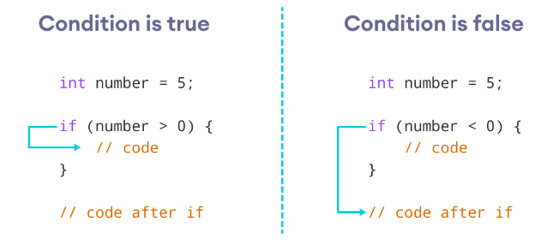
How if statement works

Slide 11
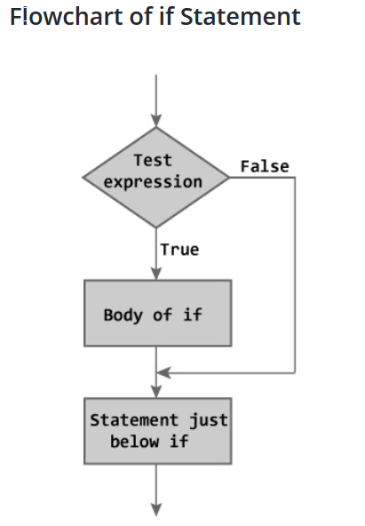

Slide 12
Syntax
if(condition)
action
if the condition is true then execute the action.
action is either a single statement or a group of statements within braces.
condition
false
true
action

Slide 13
Example 1: C++ if Statement
// Program to print positive number entered by the user // If user enters negative number, it is skipped
#include <iostream>
using namespace std;
int main()
{
int number;
cout << "Enter an integer: ";
cin >> number;
if ( number > 0) // checks if the number is positive
{
cout << "You entered a positive integer: " << number << endl;
}
cout << "This statement is always executed.";
return 0;
}

Slide 14
The if-else Statement:
.
The if statement along tells us that if a condition is true it will execute a block of statement and if the condition is false it won't.
So, we can use the else statement with if statement to execute a block of code when condition is false.
The if statement can have an optional else clause

Slide 15
The syntax of the if….else statements is
if (condition)
{
// block of code only executed if condition is true
}
else
{
// block of code only executed if condition is false
}
if (condition) // if part
{
Statement1;
statement2;
}
else // else part
{
statement3;
}
The if..else statement evaluates the condition inside the parenthesis ( )

Slide 16
The if… else executes the codes inside the body of if, if the test expression is true and skips the codes inside the body of else.
If the test expression is false, it executes the codes inside the body of else statement and skips the codes inside the body of if.
The if - else statement causes one of the two possible statement( s) to execute, depending upon the outcome of the condition

Slide 17
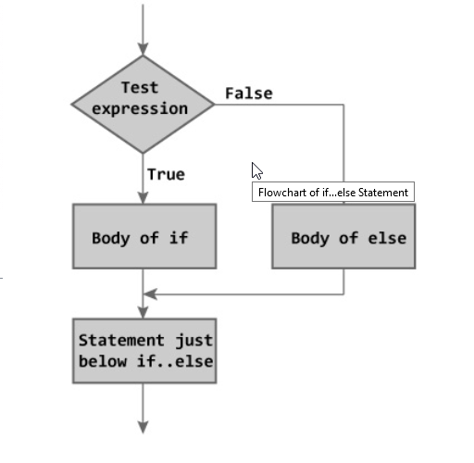
Flow Chart of if—else statement

Slide 18
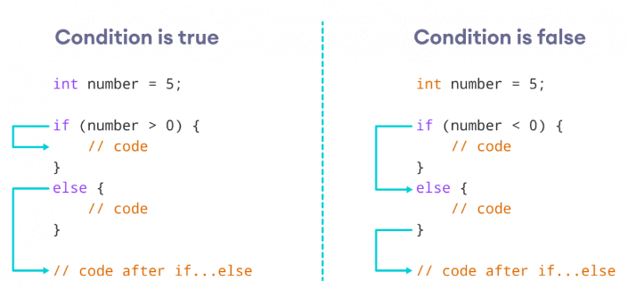
How if…else statement works?

Slide 19
If the condition evaluates true,
the code inside the body of if is executed
the code inside the body of else is skipped from execution
If the condition evaluates false,
the code inside the body of else is executed
the code inside the body of if is skipped from execution

Slide 20
Example : A code segment to determine the greater of two numbers
if(x>y)
cout<<”X is greater”;
else
cout<<”y is greater”;
•

Slide 21
// Program to check whether an integer is positive or negative // This program considers 0 as positive number
#include <iostream>
using namespace std;
int main()
{
int number;
cout << "Enter an integer: ";
cin >> number;
if ( number >= 0)
{
cout << "You entered a positive integer: " << number << endl;
}
else
{
cout << "You entered a negative integer: " << number << endl;
}
cout << "This line is always printed.";
return 0;
}

Slide 22
C++ if-else ladder statement
if...else-if...else statement is used when we need to check multiple conditions.
The if...else statement is used to execute a block of code among two alternatives.
However, if we need to make a choice between more than two alternatives, we use the if...else-if...else statement.
In this control structure we have one if and one else, however we can have multiple else-if blocks.

Slide 23
C++ if-else ladder statement
if (condition1)
{
// statement 1
}
else if (condition2)
{
// statement 2
}
else
{
// statement 3
}

Slide 24
Here,
If condition1 evaluates to true, the statement 1 is executed.
If condition1 evaluates to false, then condition2 is evaluated.
If condition2 is true, the statement 2 is executed.
If condition2 is false, the statement 3 is executed

Slide 25
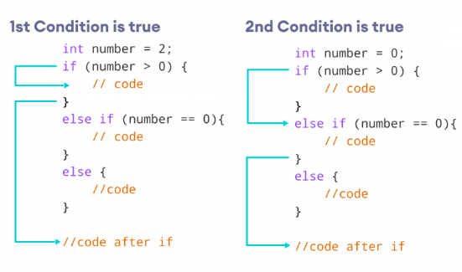
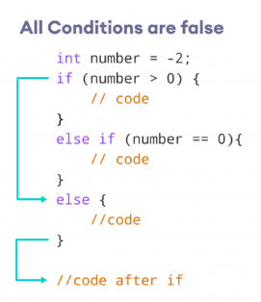
How if...else-if...else Statement Works

Slide 26
Program to check whether an integer is positive, negative or zero
#include <iostream>
using namespace std;
int main() {
int number;
cout << "Enter an integer: "; cin >> number;
if (number > 0)
{
cout << "You entered a positive integer: " << number << endl;
}
else if (number < 0)
{ cout << "You entered a negative integer: " << number << endl;
} else
{
cout << "You entered 0." << endl;
}
cout << "This line is always printed."; return 0; }

Slide 27
Nested if-else Statement:
Nested if statement. Is used at time, we need to use an if statement inside another if statement.
The nested if...else statement allows you to check for multiple test expressions and execute different codes for more than two conditions
A nested if-else statement contains one or more if-else statements.
Think of it as multiple layers of if statements. There is a first, outer if statement, and inside it is another, inner if statement.

Slide 28
The syntax of Nested if is:
// outer if statement
if (condition1)
{
// statements
// inner(nested) if statement
if (condition2)
{
// statements
}
}

Slide 29
The if-else statement is nested within the else part. The syntax is
if (testExpression1)
{
// statements to be executed if testExpression1 is true
}
else if(testExpression2)
{ // statements to be executed if testExpression1 is false and testExpression2 is true
}
else if (testExpression 3)
{
// statements to be executed if testExpression1 and testExpression2 is false and testExpression3 is true
} . .
else { // statements to be executed if all test expressions are false }

Slide 30
Notes:
We can add else and else if statements to the inner(nested) if statement as required.
The inner if statement can also be inserted inside the outer else or else if statements (if they exist).
We can nest multiple layers of if statements.

Slide 31
Example nested If
// C++ program to find if an integer is even or odd or neither (0) // using nested if statements
#include <iostream>
using namespace std;
int main()
{ int num;
cout << "Enter an integer: ";
cin >> num; // outer if condition
if (num != 0)
{ // inner(nested) if condition
if ((num % 2) == 0)
{ cout << "The number is even." << endl;
} // inner(nested) else condition
else {
cout << "The number is odd." << endl;
}
} // outer else condition
else {
cout << "The number is 0 and it is neither even nor odd." << endl;
}
cout << "This line is always printed." << endl;
return 0;
}

Slide 32
To understand the concept of nested if-else, consider this example.
Example : A code segment to determine the largest of three numbers
if (a>b)
{
if (a>c)
cout<<”a is largest”;
}
else //nested if-else statement within else
{
if (b>c)
cout<<”b is largest”;
else
cout<<”c is largest”;
}

Slide 33
Conditional Operator as an Alternative
The conditional operator '? :' selects one of the two values or expressions based on a given condition. Due to this decision-making nature of the conditional operator, it is sometimes used as an alternative to if-else statements. Note that the conditional operator selects one of the two values or expressions and not the statements as in the case of an if-else statement. In addition, it cannot select more than one value at a time, whereas if-else statement can select and execute more than one statement at a time. For example, consider this· statement.
max = (x>y ? x : y)
This statement assigns maximum of x and y to max

Slide 34
C++ Ternary Operator
Ternary operator are a substitute for if...else statement. So before you move any further in this tutorial, go through C++ if...else statement (if you haven't).
The ternary operator allow us to execute different code depending on the value of a condition, the result of the expression is the result of the executed code.
The conditional operator is kind of similar to the C++ if...else statement as it does follow the same algorithm as of C++ if...else statement but the conditional operator takes less space and helps to write the if-else statement in the shortest way possible.
The Ternary operator returns one of two values depending on the result of an expression.

Slide 35
Syntax of Ternary Operator
Condition ? Expression1 : Expression2;
The ternary operator works as follows:
If the expression stated by Condition is true, the result of Expression1 is returned by the ternary operator.
If it is false, the result of Expression2 is returned.

Slide 36
If…. else vs ternary Operator
if (number % 2 == 0)
{
Even = true;
}
else
{
Even = false;
}
;
Even = (number % 2 == 0) ? true : false;

Slide 37
Example 1: C++ Program to find the even or odd number using Ternary Operator
/ Lets understand the ternary operator to find the even or odd number
#include <iostream>
using namespace std;
int main(){
int n;
cout << "Enter an integer: ";
cin >> n;
(n % 2 == 0) ? cout << n << " is even." : cout << n << " is odd.";
return 0;
}

Slide 38
Example 2
// Program to find maximum number using ternary operator
#include <iostream>
using namespace std;
int main()
{
int a = 10;
int b = 30;
int max = a > b ? a : b;
cout << "Maximum Value: " << max << "\n";
return 0;
}

Slide 39
The switch Statement:
Switch case statement is control statement that is regarded as a substitute for if-else statements. Switch statements are used for long if-else statements that compare a variable to several integral values.
The Switch statement is a multiway branch statement. It provides an easy way to dispatch execution to different parts of code based on the value of the expression.
Switch is a control statement that allows a value to change control of execution.

Slide 40
Switch statement
Switch case statement is used when we have multiple conditions and we need to perform different action based on the condition. When we have multiple conditions and we need to execute a block of statements when a particular condition is satisfied. In such case either we can use lengthy if..else-if statement or switch case.
The problem with lengthy if..else-if is that it becomes complex when we have several conditions. The switch case is a clean and efficient method of handling such scenarios.

Slide 41
The syntax of the switch statement
The switch statement allows us to execute a block of code among many alternatives
switch (expression)
{
case 1: // code to be executed if the expression is equal to case 1 // break statement execute
break;
case 2:
// code to be executed if the expression is equal to case 2 // break statement execute
break; .
default: // code to be executed if the expression doesn't match any case
}

Slide 42
You need to keep things in mind when using a Switch Statement:
The expression provided in the switch must be a constant value otherwise it is invalid.
Duplicate case values are not allowed.
The default statement is optional. Even if the switch case statement do not have a default statement, it would work without any problem.
The break statement is used to take control out of the loop otherwise all the cases before a break would be executed.
break statement is used inside the switch to terminate a statement sequence. When a break statement is reached , the switch terminates, and the flow of control jumps to next line following the switch statement.
The break statement is optional. If omitted, execution will continue on into the next case. The flow of control will fall though to subsequent cases until a break is reached.
The switch statement can also be nested, which means you have switch statements inside another switch.

Slide 43
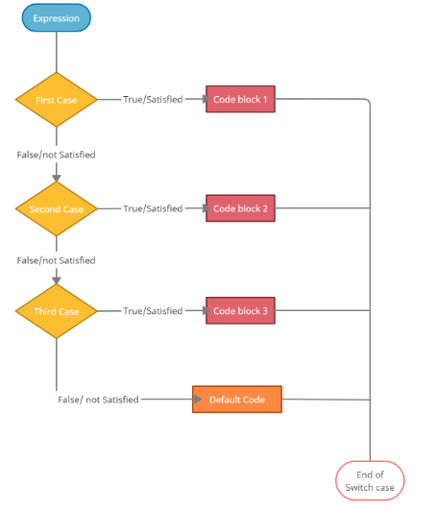
Flow Chart of Switch statement

Slide 44
How does the switch statement work?
The expression is evaluated once and compared with the values of each case label.
The value of this expression is then compared with the first case. if the first case matches then the block of code associated with the first case is executed.
Once the break is encountered, the execution stops and the switch statement terminates.
However, if the case does not match, the execution flows to the next case.
If this case matches, then the second code block executes otherwise, the flow checks the next case.
In case the value is not equal, the code after default: is executed.
Note: We can do the same thing with the if...else..if ladder. However, the syntax of the switch statement is cleaner and much easier to read and write.

Slide 45
Example 1: C++ Program to understand the switch Statement
// a simple program to understand switch Statement #include <iostream>
using namespace std;
int main()
{
int a = 1;
switch (a)
{ case 1:
cout << n1 << "My Choice is 1";
break;
case 2: cout << n1 << "My Choice is 2";
break; case 3: cout << n1 << "My Choice is 3";
break;
default: // Variable "a" doesn't match any case
cout << "Invalid! The Choice is not correct";
break;
} return 0; }

Slide 46
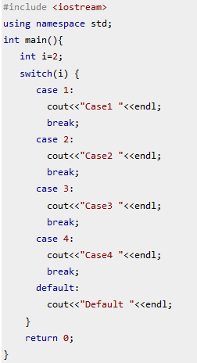
Example2 Switch statement with break statement.
TRY THE SAME CODE WITH OUT BREAK

Slide 47
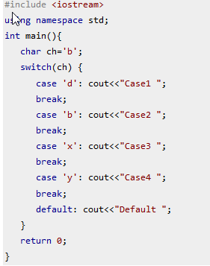
Example 3 use characters in switch case.
Nesting of switch statements are allowed, which means you can have switch statements inside another switch. However nested switch statements should be avoided as it makes program more complex and less readable

Slide 48
Example 4
To understand the concept of switch statement, consider this code segment.
Example : A code segme!1t to demonstrate the use of switch statement
int x;
cin>>x;
switch(x)
{
case l: cout<<"Option1 is selected";
break;
case 2: cout<<"Option2 is selected";
break;
case 3: cout<<"Option3 is selected";
break;
case 4: cout<<"Option4 is selected;
break;
default: cout<<"Invalid option!";
}

Slide 49
In this example, depending upon the input, an appropriate message is displayed.
That is, if 2 is entered, then the message Option 2 is selected is displayed.
In case, 5 is entered, then the message Invalid option! is displayed.
Similar to if and if-else statements, switch statements can also be nested within one another.
A nested switch statement contains one or more switch statements within its case label or default label (if any).

Slide 50
Example:
int mortgageTerm;
float interestRate;
cin>> mortgageTerm;
Switch (mortgageTerm) {
case 10:
interestRate= 3.0;
break;
case 15:
interestRate=3.5;
break;
case 30:
interestRate=4.0;
break;
default:
cout<<“please enter a valid loan term”;
}

Slide 51
Switch statement Example2
char grade;
cin >> grade;
switch (grade) {
case 'A': cout << "Great job!!";
break;
case 'B': cout << "Good job";
break;
case 'C': cout << "Satisfactory job";
break;
case 'D': cout << "Hmmm ... need to work a little harder";
break;
case 'F': cout << "Sorry, you failed the class";
break;
default: cout << "The letter you typed " << grade << " is not a valid grade";
}

Slide 52
int x, y;
cin>>x>>y;
switch (x>y) {
case 0:
cout<<“x is no greater than y”;
break;
case 1:
cout<<“ x is greater than y”;
break;
default:
}
int x, y;
cin>>x>>y;
switch (x>y) {
case false:
cout<<“x is no greater than y”;
break;
case true:
cout<<“ x is greater than y”;
break;
default:
}

